Slide 1

Breast Cancer Research Analysis
Presented by:
Loraine Gomez
Shwet ‘Sunny’ Bhatt

Slide 2

PROJECT IDEA GENERATION
Initially our goal was to utilize data related to lung cancer research from various sources such as Kaggle, Data World and the official source SEER*STAT.
The plan was to retrieve lung cancer research data from 2010 – 2019 using SEER*Stat and then use the ETL process to get final database with lung nodules (Metastatic vs Primary, Malignant/Non-Malignant) and compare it with other variables such as geographic location, age, gender, race etc.

Slide 3

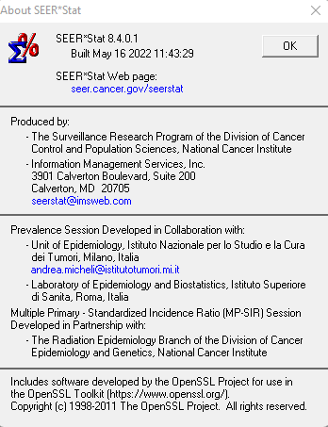
Using SEER*Stat for data retrieval

Slide 4

Challenges with SEER*STAT data
The dataset was too big, and it was challenging to compile the raw data into a .txt/.csv(utf-8)
When we did manage to save the data, we found it to be cancer data for all types and without knowledge of correct ICD codes it was very difficult to pinpoint variables that would relate to lung cancer.
We had a very short timeframe for this project not to mention our deep learning assignment using Amazon Web Services (RDS) also going on at the same time.

Slide 5
Our team was running out of time and thus we decided to drop the idea for lung cancer data and used our secondary data source which is the breast cancer data from the UC Irvine Machine Learning Repository.
(https://archivebeta.ics.uci.edu/dataset/17/breast+cancer+wisconsin+diagnostic)

Slide 6
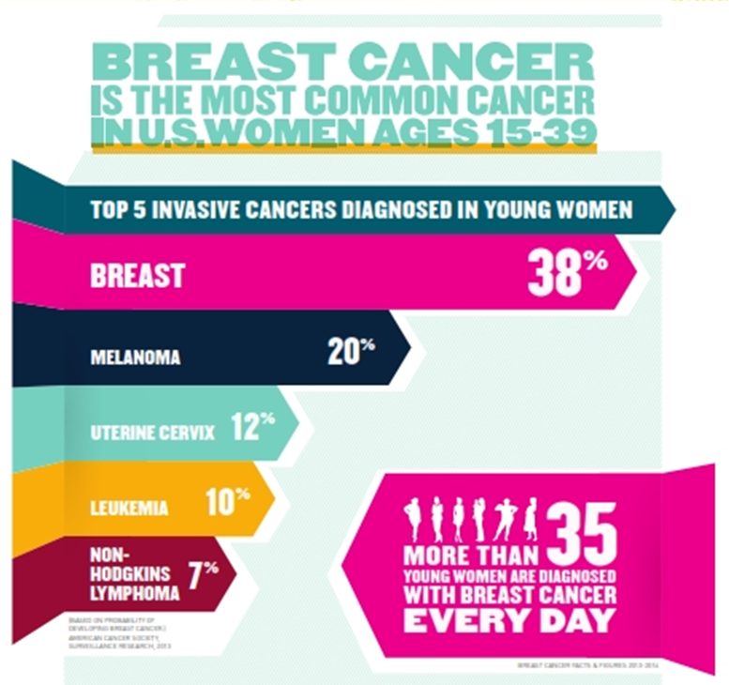
Facts about breast cancer
Nearly 80 percent of young women diagnosed with breast cancer find their breast abnormality themselves.¹
1 in 8 women in the United States will be diagnosed with breast cancer in her lifetime.²
Although rare, men get breast cancer too. In 2022, an estimated 2,710 men will be diagnosed with breast cancer in the U.S. and approximately 530 men will die from breast cancer. ²
There are over 3.8 million breast cancer survivors in the United States. ²
1 Ruddy, K. et al., "Presentation of breast cancer in young women," Journal of Clinical Oncology 27:15S (2009).,2 https://www.nationalbreastcancer.org/breast-cancer-facts

Slide 7
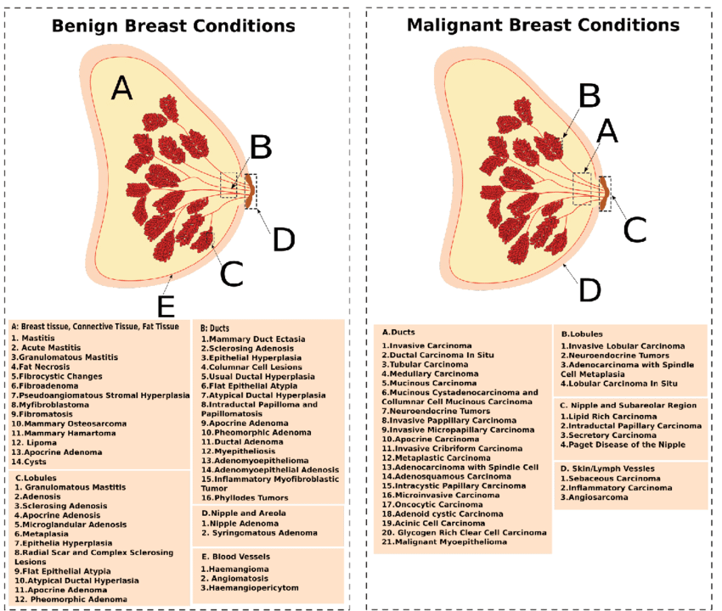
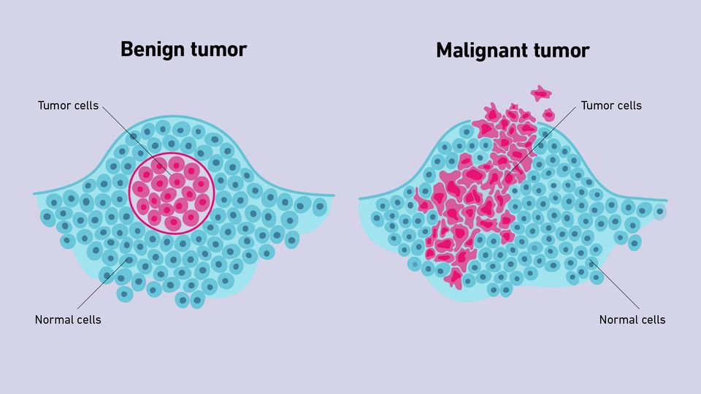
Malignant and Benign tumor
https://lydacoatox.blogspot.com/2020/06/benign-neoplasm-of-breast.html
https://www.technologynetworks.com/cancer-research/articles/benign-vs-malignant-tumors-364765

Slide 8
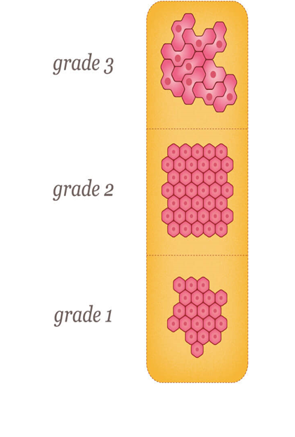
Breast Cancer Data
ID number
Diagnosis (M = malignant, B = benign)
3-32)
Ten real-valued features are computed for each cell nucleus: a) radius (mean of distances from center to points on the perimeter) b) texture (standard deviation of gray-scale values) c) perimeter d) area e) smoothness (local variation in radius lengths) f) compactness (perimeter^2 / area - 1.0) g) concavity (severity of concave portions of the contour) h) concave points (number of concave portions of the contour) i) symmetry j) fractal dimension ("coastline approximation" - 1)
https://www.nationalbreastcancer.org/breast-tumors/

Slide 9
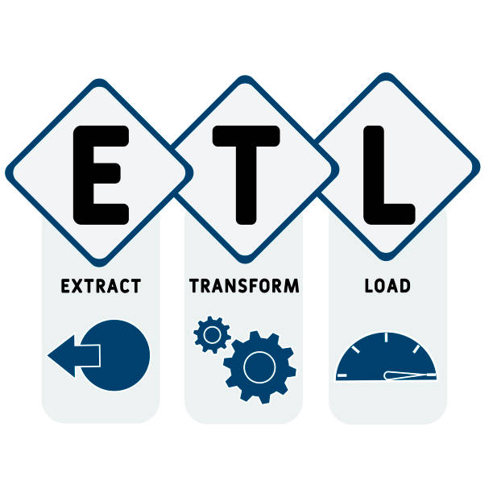



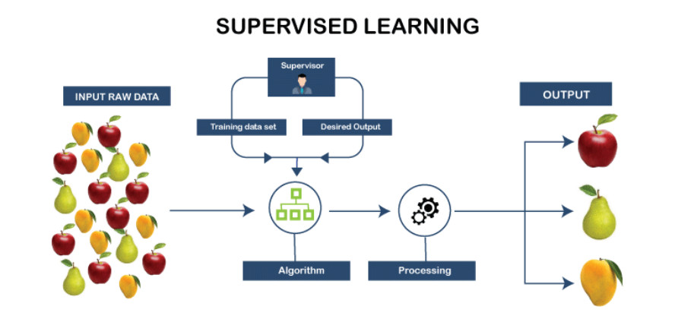

Slide 10
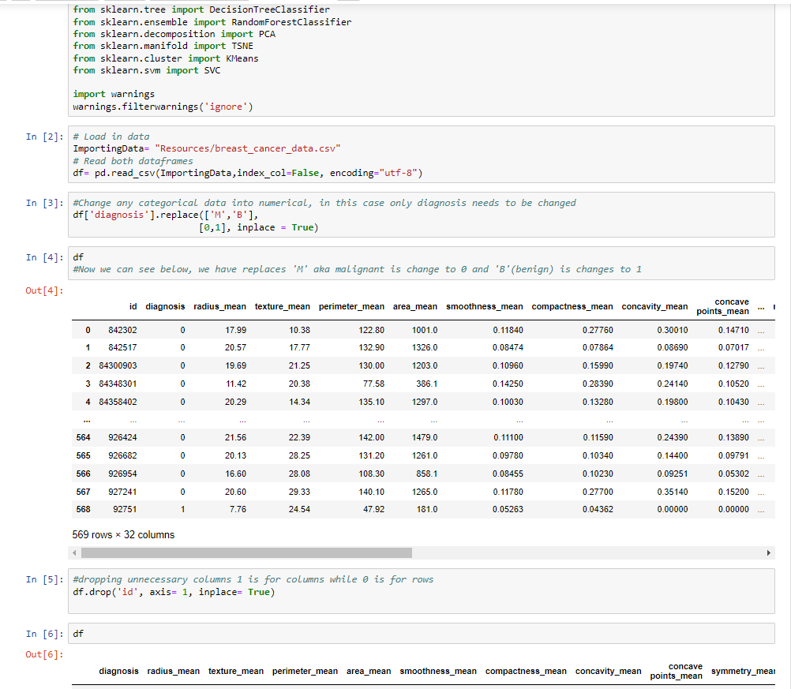
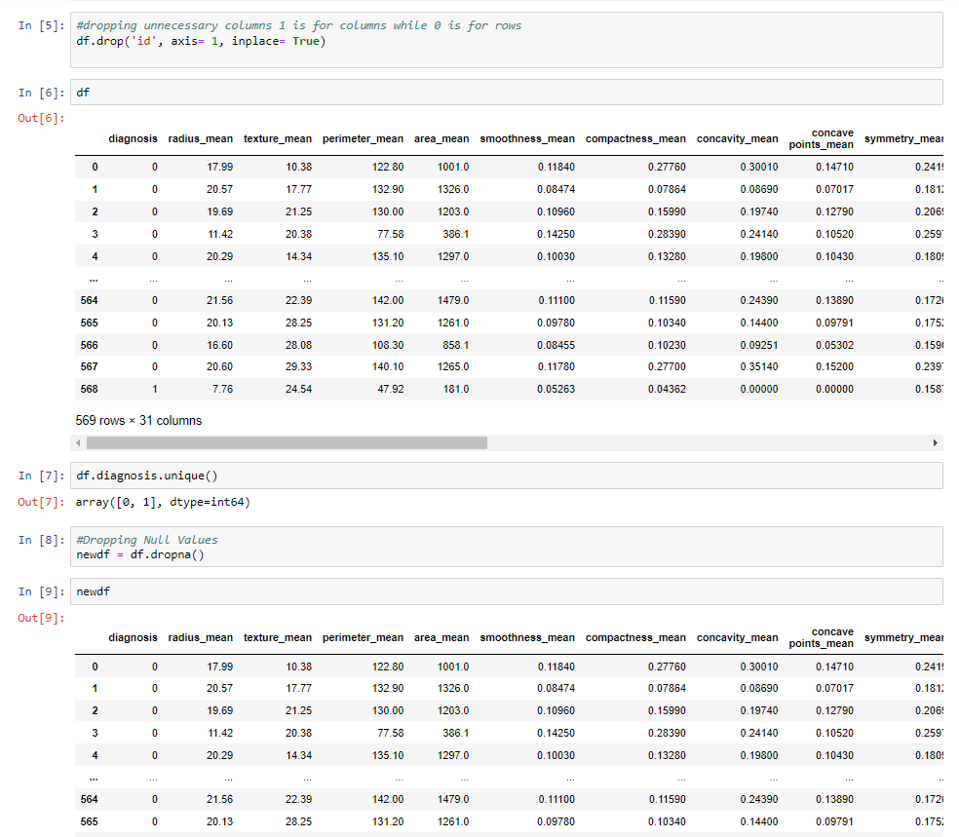
ETL process(Breast_cancer.ipynb)

Slide 11
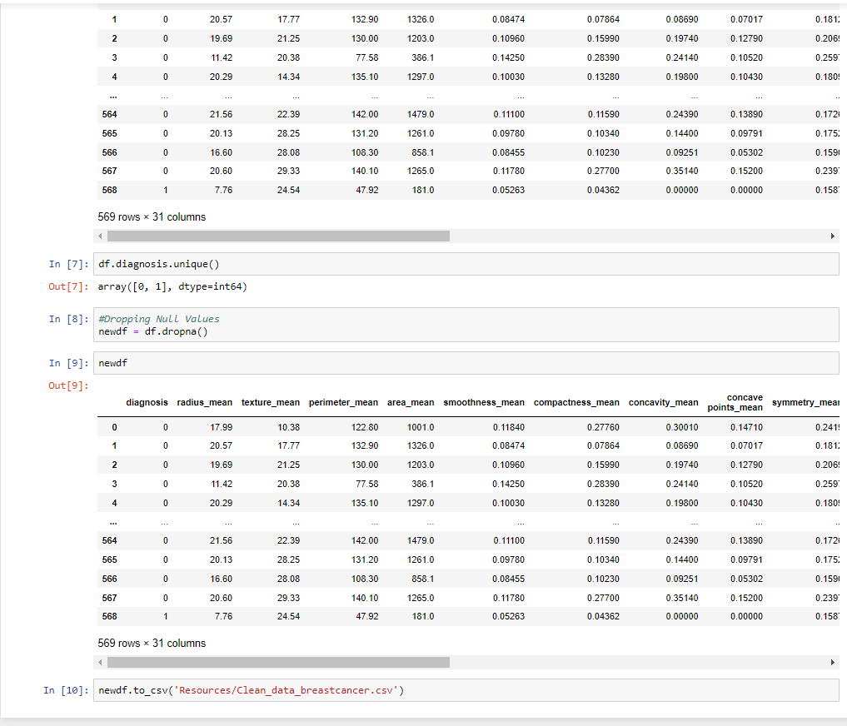

ETL process

Slide 12
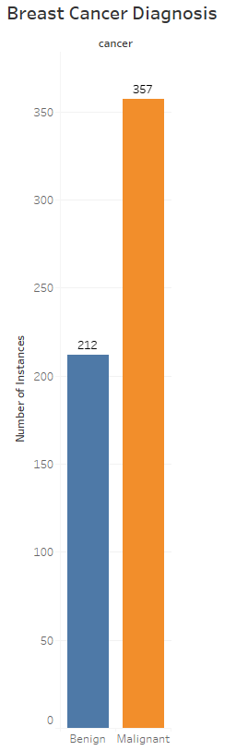
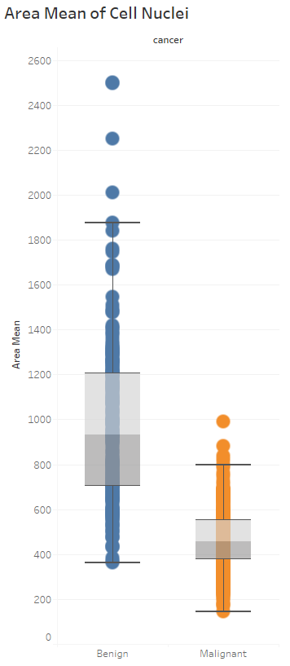
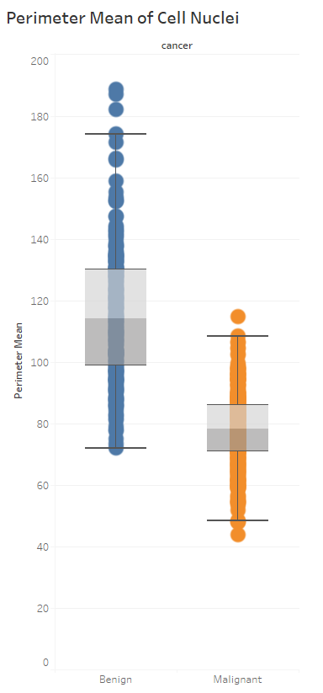
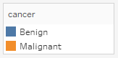
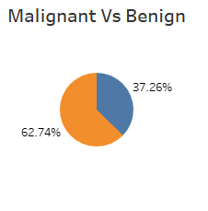
Breast Cancer Visuals

Slide 13
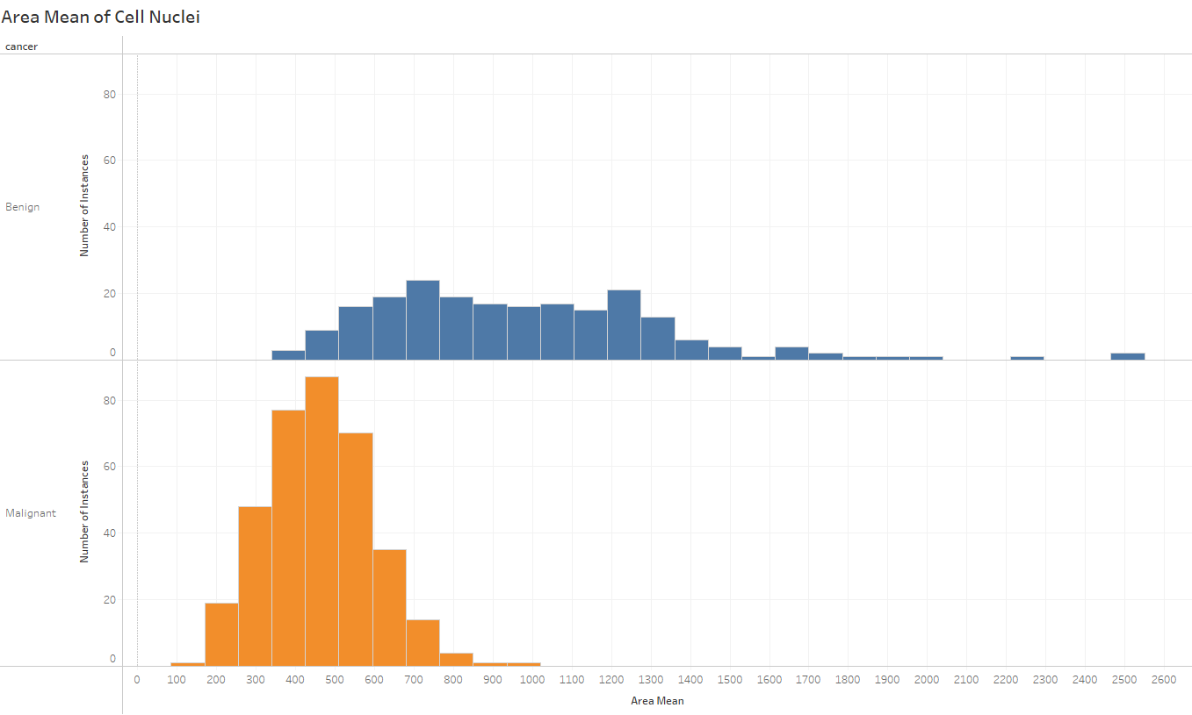
Breast Cancer Visuals (area)

Slide 14
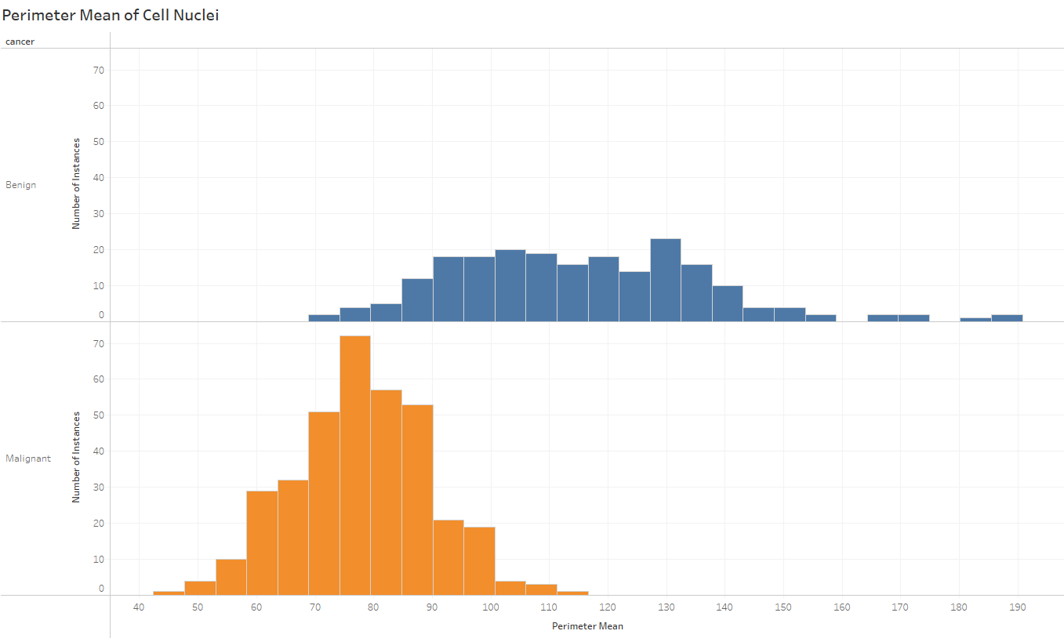
Breast Cancer Visuals (perimeter)

Slide 15
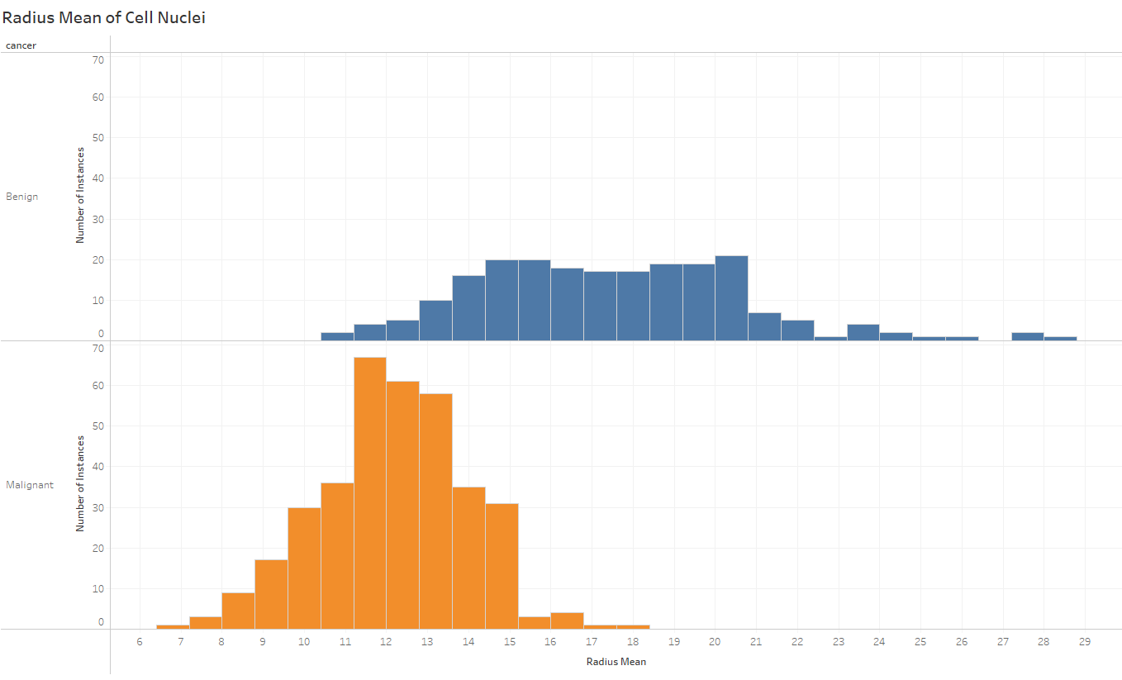
Breast Cancer Visuals (radius)

Slide 16

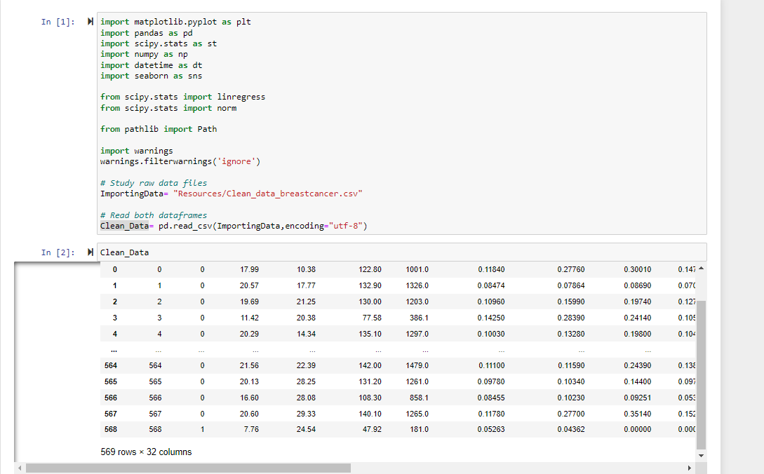
Machine Learning

Slide 17
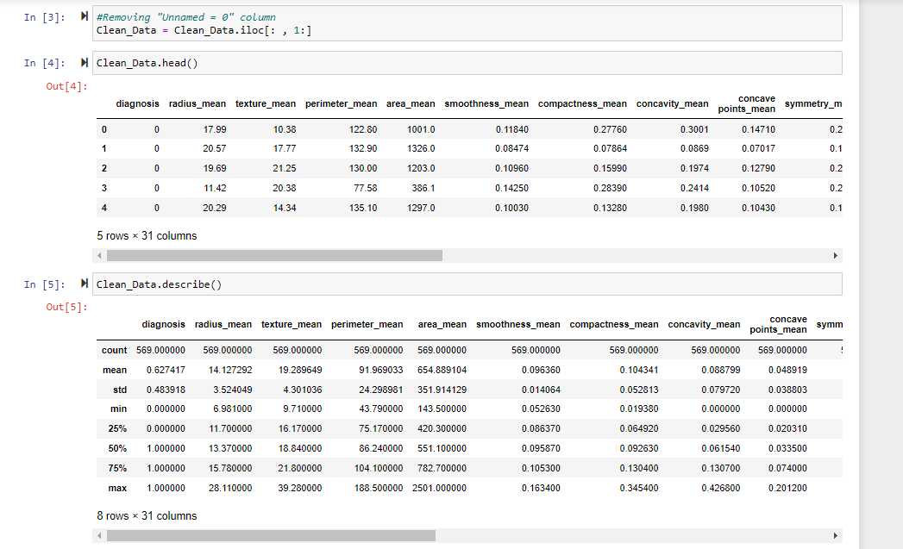
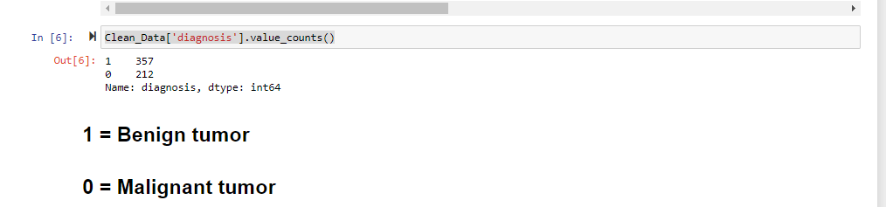

Slide 18
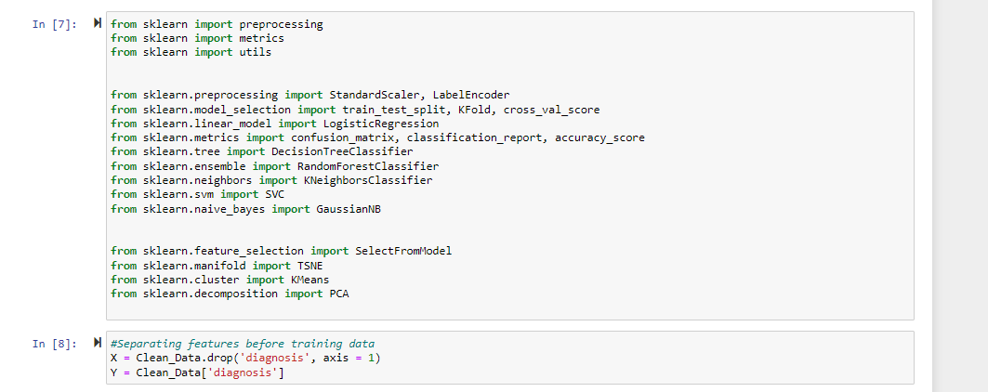

Slide 19
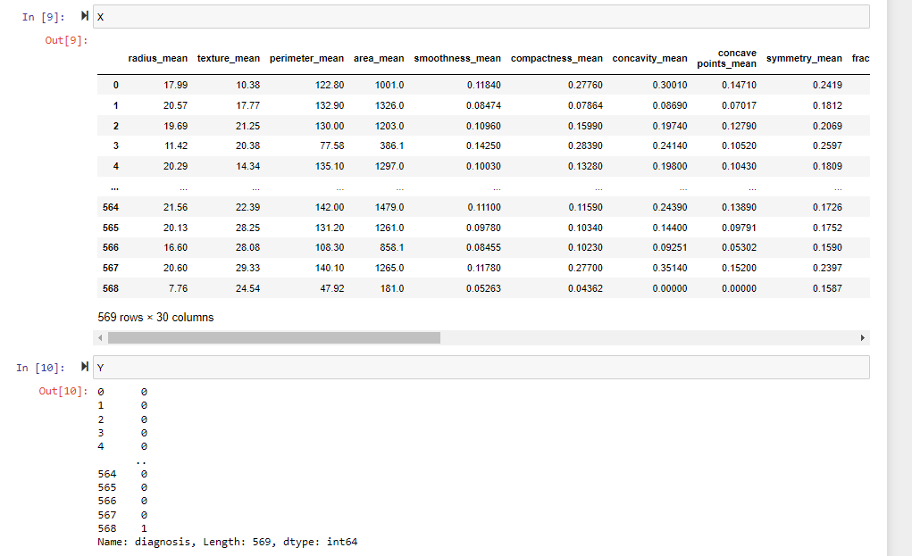

Slide 20
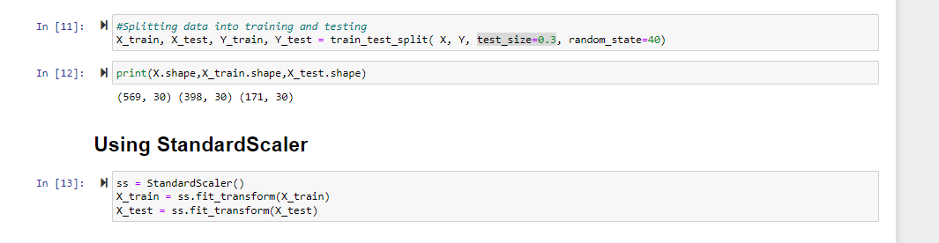

Slide 21
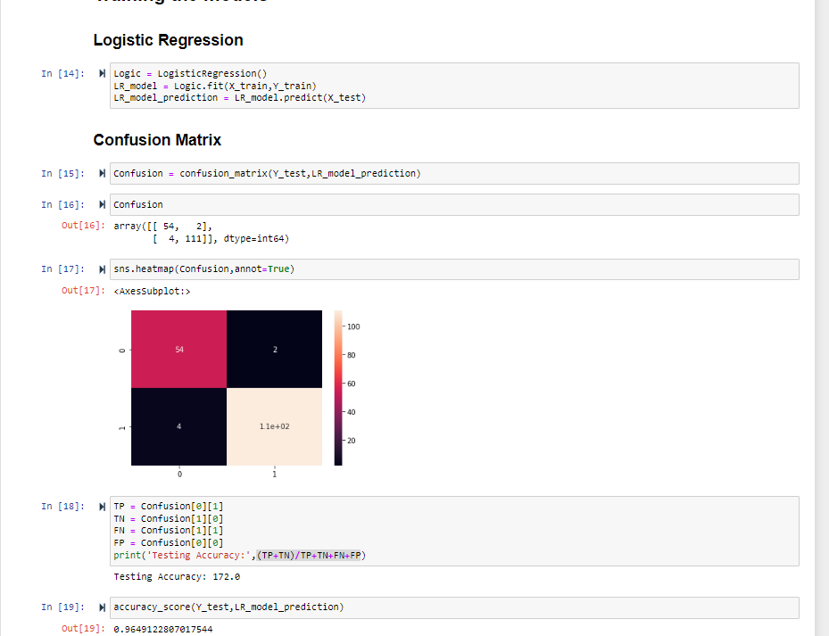

Slide 22
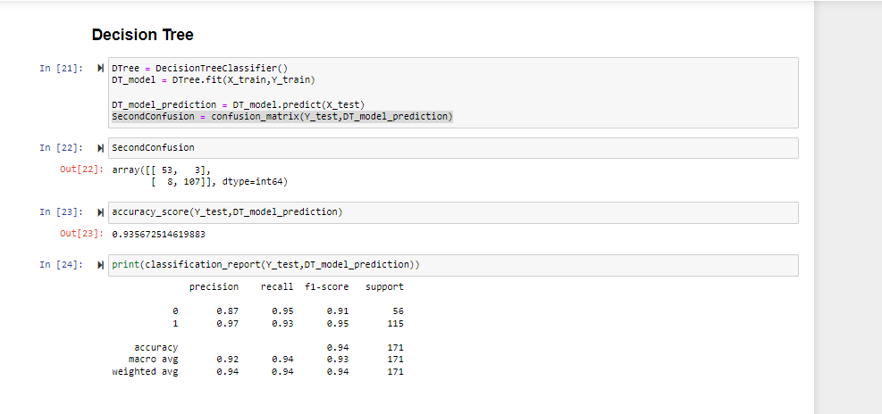

Slide 23
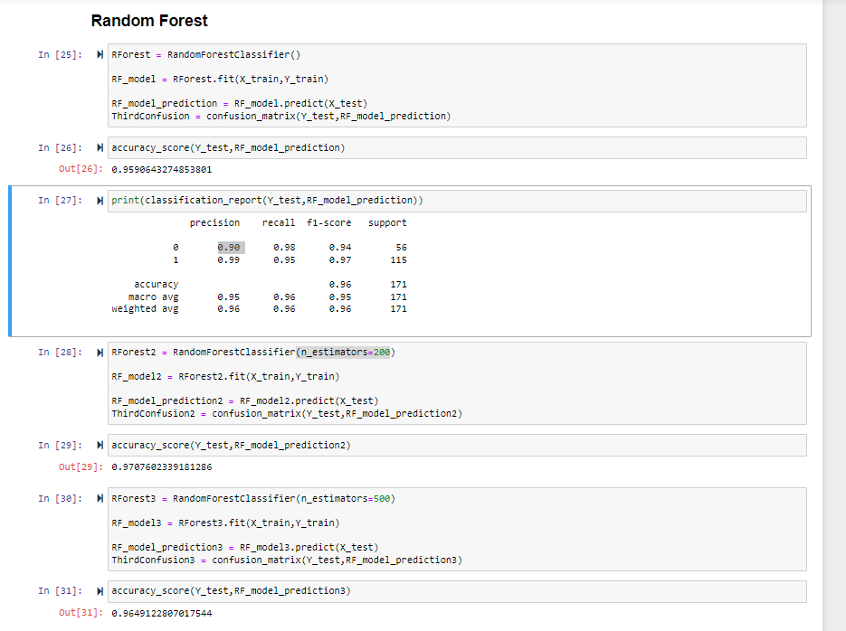

Slide 24
Conclusion

